Slide 1
Implementing a 3-way Handshake using UDP
Implementation, specifications, states and uses

Slide 2
Outline
Implementation
Review of header structure.
Differences from default UDP
Benefits and use cases
Scope and further expansion
Conclusion

Slide 3
Implementation

Slide 4
Packet definition
UDPPacket defines a class representing a UDP packet.
Source port, destination port, sequence number, acknowledgment number, flags, checksum and data are listed as attributes
It also includes a method to calculate the checksum of the packet, for handshake verification.

Slide 5
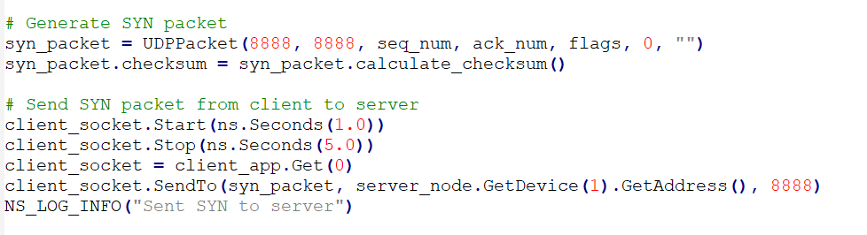
Mechanism of Handshake
The code generates a SYN packet from the client to the server and sends it with checksum attached.

Slide 6
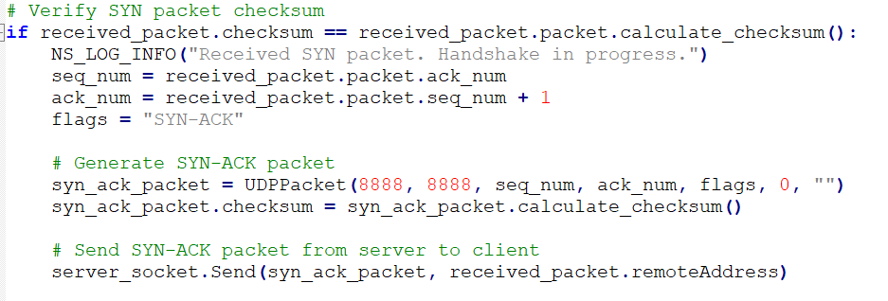
Mechanism of Handshake
The server receives the SYN packet, verifies its checksum, and if valid, generates a SYN-ACK packet and sends it back to the client.

Slide 7
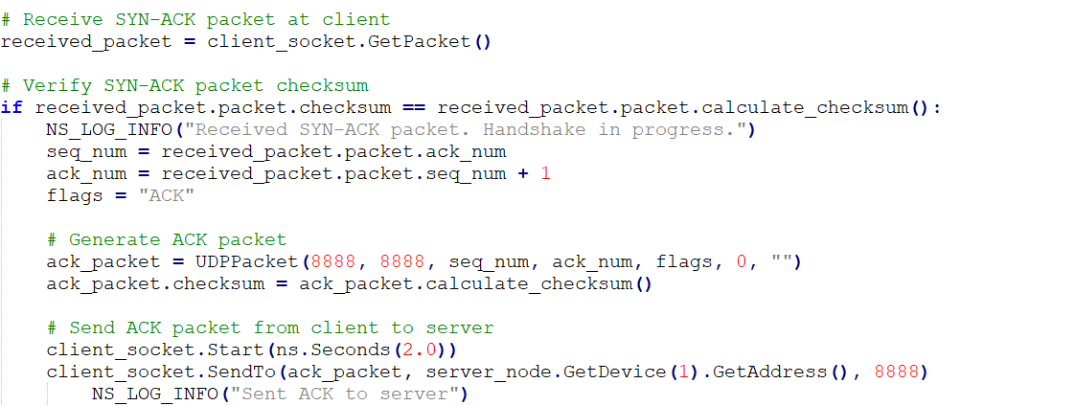
Mechanism of Handshake
The client receives the SYN-ACK packet, verifies its checksum, and if valid, completes the handshake by sending an ACK packet to the server.

Slide 8
Mechanism of Handshake
Log whether the handshake is successful or not.

Slide 9
Why break protocol? A review of header structures.

Slide 10
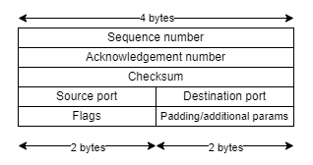
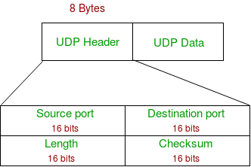
Why break protocol?
UDP header structure
H-UDP header structure
Source Port: 2 bytes
Destination Port: 2 bytes
Sequence Number: 4 bytes
Acknowledgment Number: 4 bytes
Flags: 2 bytes
CRC32 Checksum: 4 bytes
Resembles TCP header to match TCP-spec handshake procedure closely. 2 additional bytes for padding and special parameters
There is no way to perform a full handshake, since stock UDP has no mechanism of counting packets.
This would lead to echo-handshakes, which are redundant.

Slide 11
Other differences
UDP
H-UDP
Completely stateless and connectionless.
Self-contained.
Server and client are independent entities.
Involves states for client and server.
Transitions to UDP for data transfer.
Server state is dependent on client’s establishment or termination of connection.

Slide 12
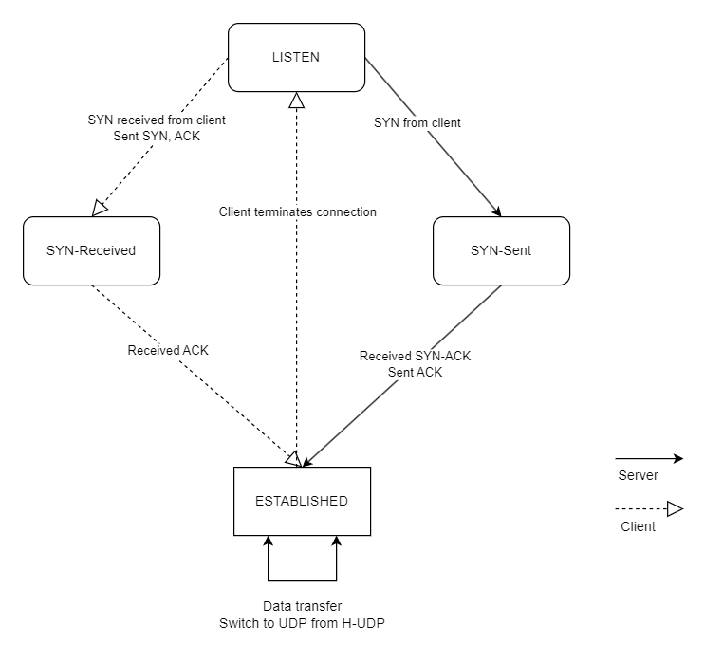
State machine for H-UDP
Resembles a simplified TCP state machine without the disconnection mechanism.
Can handle disconnection the same way UDP does, simply by stopping client or server-side transmission when needed.
Server switches directly from ESTABLISHED to LISTEN state when packets stop transferring after a waiting period (similar to TIME_WAIT on TCP).

Slide 13

Benefits and uses
Allows a faster and simpler handshake mechanism than TCP.
The checksum functionality is built into the handshake packet generation function.
Allows testing of connection integrity
Handshakes can be performed more than once an arbitrary number of times – Packet loss measurement
Authentication built into UDP - replacement for client-side cookies
Example: Video streaming services
Basic flow control and Reliability
Sequence and Acknowledgement fields help here

Slide 14
Scope of improvements and expansions
Functional simulation with the specified logic (in C++/Python).
Retrying handshake on failure.
Switch to default UDP for data transmission on handshake success.
Checksum/hash generation from user environment to establish identity.

Slide 15
Scope of improvements and expansions
Implementation under different conditions to analyze performance.
Possible integration with default UDP in Checksum field.
Generation of unique identifier to authenticate on UDP applications.
TLS implementation

Slide 16

Possible alternate methodologies
We utilize the in-spec checksum in the UDP header
Handshake using purely the checksum field.
Reliability without sequence and acknowledgement fields?
QUIC over UDP
Implements connection, reliability and states over UDP transmission
No conventional handshake

Slide 17
Conclusion
This project tries to implement a handshaking system by modifying the UDP protocol.
Lower latency and overhead compared to TCP handshaking
May be simulated with C++ implementation using native ns-3 libraries

